Slide 1

E-Kirana Food/Grocery Delivery App

Slide 2

Agenda
- Objective
- Project Introduction
- Tools & Technologies used
- Functionalities Implemented
- Architecture and flow explanation
- Walkthrough & Demo
- Future Enhancements
- Q & A
- Bibliography

Slide 3


Team
Pratyush Pande
B. Tech, Electronics
Dehradun

Slide 4
Objective
- Food/grocery delivery platform
- Helps Customers to order items from shops and track delivery
- Helps Sellers to list their shop and products for sale and manage orders
- Allow Carriers to accept and coordinate deliveries
- Provide aesthetic and user-friendly front-end UI for data entry and update
- Expose Robust and Secure back-end to store and serve user data

Slide 5

Tools & technologies
HTML & CSS
TS & Angular Framework
MongoDB
SpringBoot & Spring Framework, OpenFeign, AMQP RabbitMQ
Angular Material, Google Maps API, Bootstrap

Slide 6
Functionalities Implemented
User Registration
Login & Credentials management
Shopping cart
Store front
Inventory management
Photo management and storage
Order management
Order Tracker
Delivery hub
Address manager
Google map-based locating and tracking
Order Alerts

Slide 7

Architecture & Flow diagrams

Slide 8
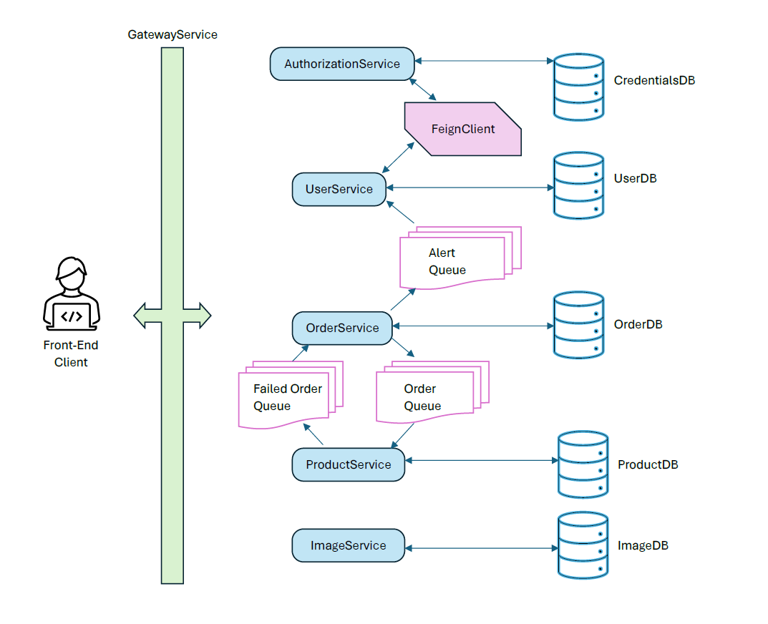

Slide 9
Walkthrough & Demo

Slide 10
Future enhancements
- Payment gateway integration like RazorPay
- Location based filtering of shops/available delivery
- Automated location update for carriers
- Alerts & notifications via SMTP
- Cart persistence between sessions
- Login via Google/ Facebook credentials
- Image storage in cloud containers like AWS S3 and Azure

Slide 11
bibliography
https://angular.io/
https://spring.io/projects/spring-boot
https://www.mongodb.com/
https://material.angular.io/
https://getbootstrap.com/docs/5.3/getting-started/introduction/
https://developers.google.com/maps/documentation/javascript
https://github.com/angular/components/tree/main/src/google-maps#readme
https://jwt.io/
https://spring.io/projects/spring-cloud-openfeign
https://cloud.spring.io/spring-cloud-netflix/multi/multi__service_discovery_eureka_clients.html

Slide 12
Questions?

Slide 13
Thank you

